Slide 1
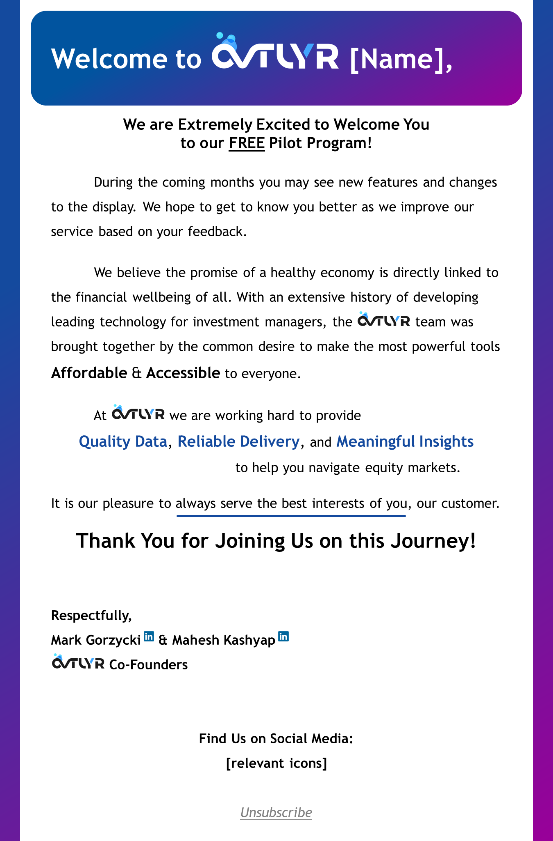

Slide 2



Welcome to [Name],
We are Extremely Excited to Welcome You
to our FREE Pilot Program!
During the coming months you may see new features and changes to the display. We hope to get to know you better as we improve our service based on your feedback.
We believe the promise of a healthy economy is directly linked to the financial wellbeing of all. With an extensive history of developing leading technology for investment managers, the team was brought together by the common desire to make the most powerful tools Affordable & Accessible to everyone.
At we are working hard to provide
Quality Data, Reliable Delivery, and Meaningful Insights
to help you navigate equity markets.
It is our pleasure to always serve the best interests of you, our customer.
Thank You for Joining Us on this Journey!
Respectfully,
Mark Gorzycki & Mahesh Kashyap
Co-Founders
Find Us on Social Media:
[relevant icons]
Unsubscribe

